Slide 1
Why Deep Learning in Biomedicine
Serafim Batzoglou
Stanford University

Slide 2
Why deep learning in biomedicine
Transformation of biomedicine into data science
The future role of deep learning
Why deep learning?
The biggest obstacle and suggestions to overcome it

Slide 3
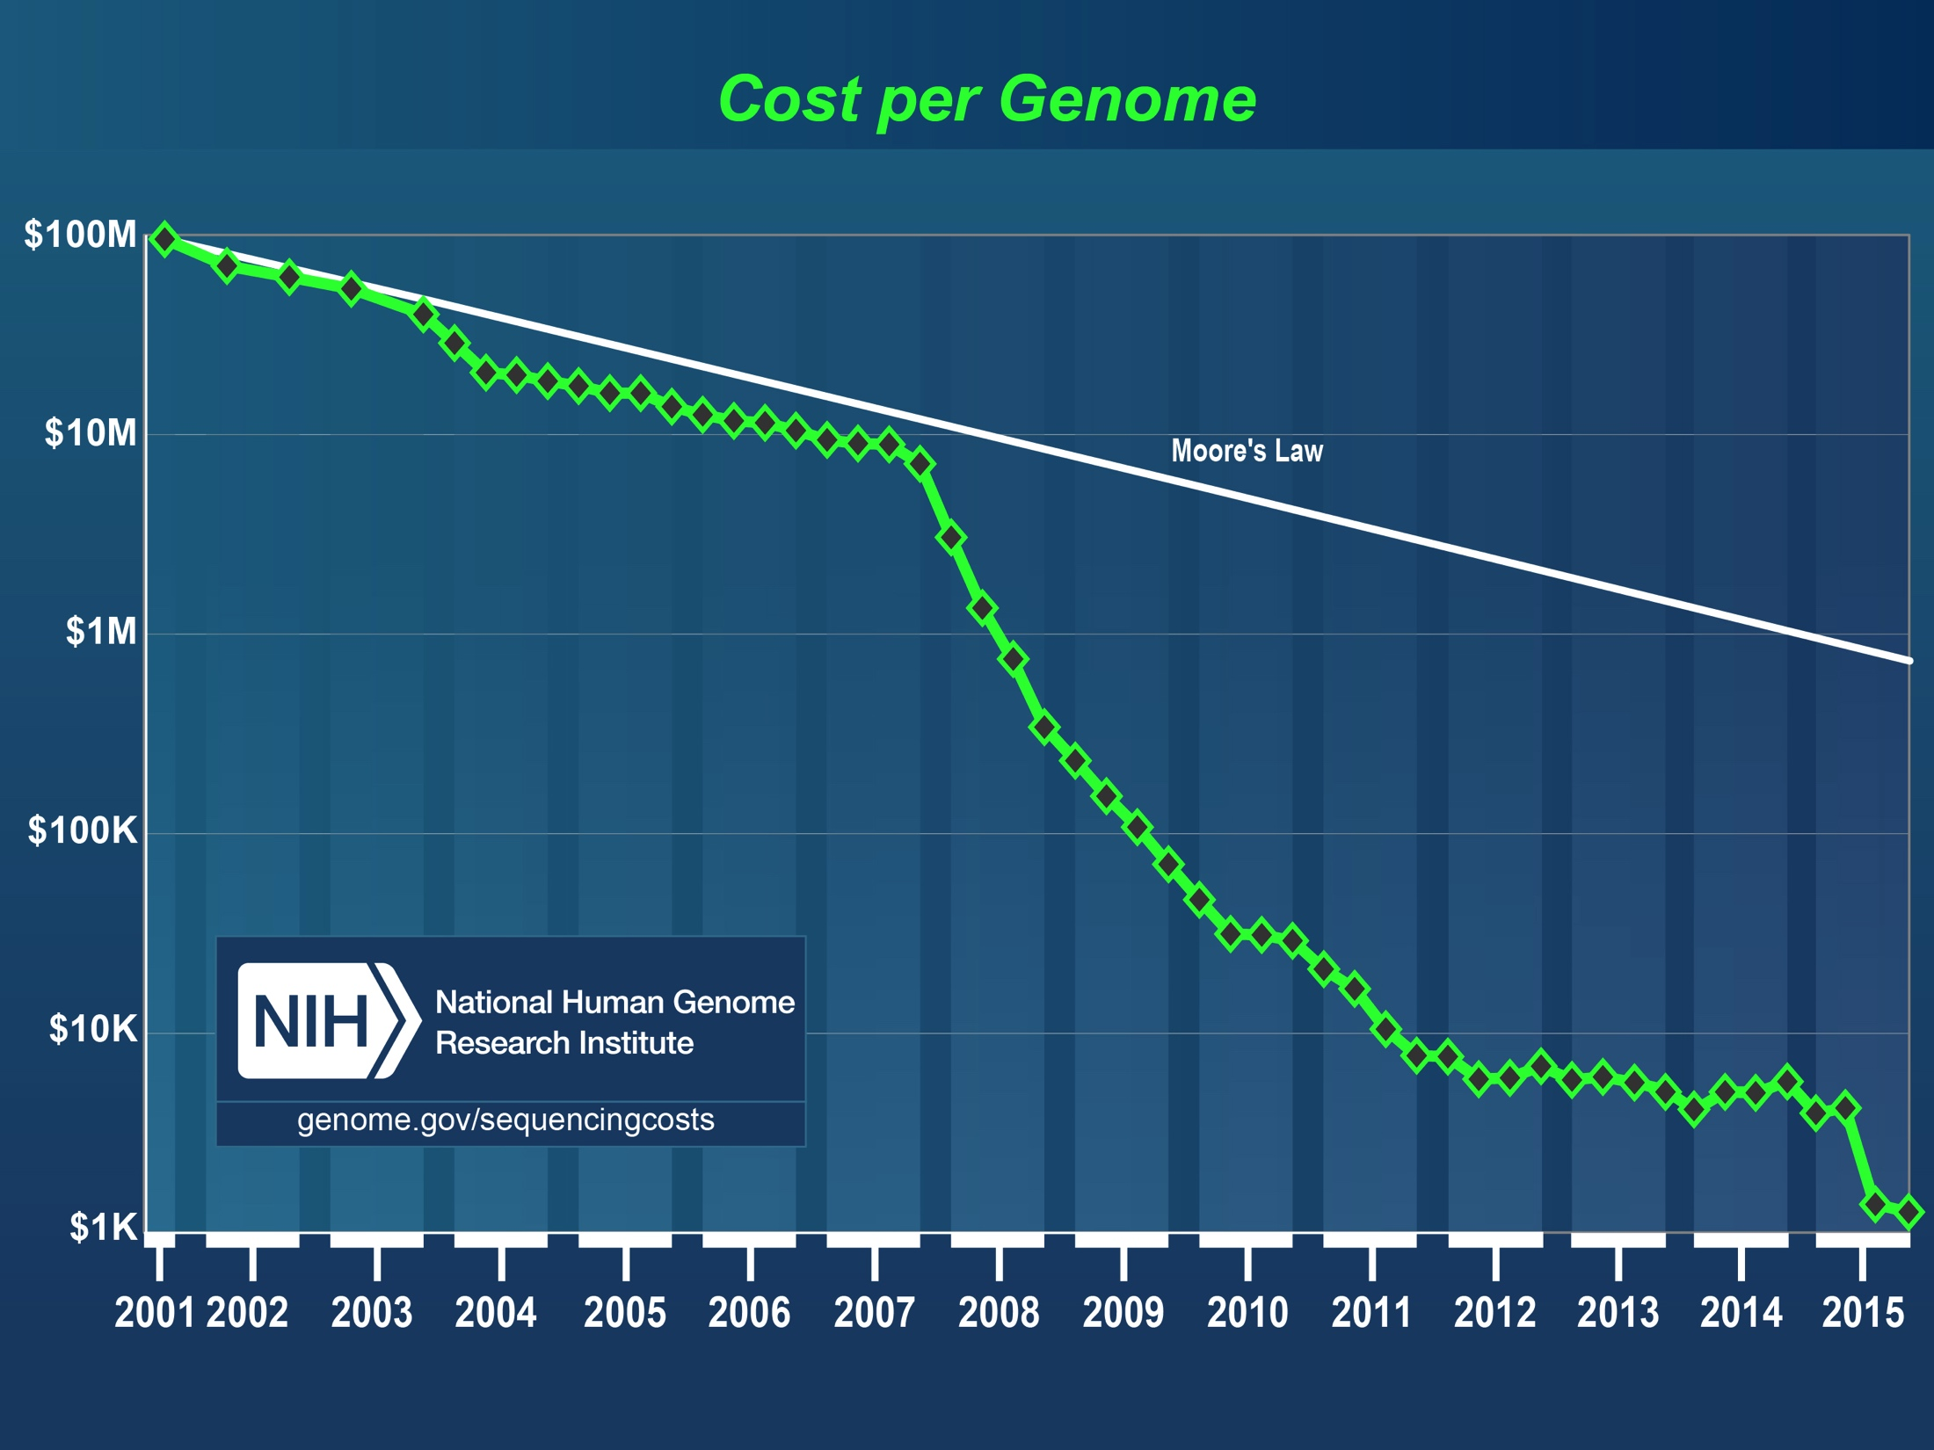

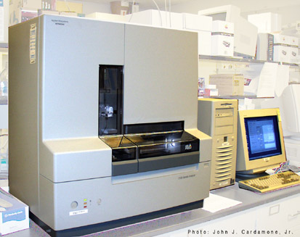
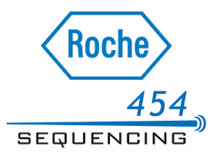
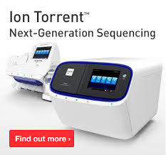


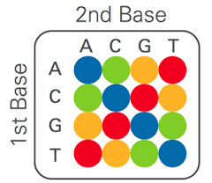

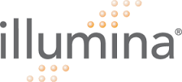
Sequencing Growth
Cost of one human genome
2000: $3,000,000,000
2004: $30,000,000
2008: $100,000
2010: $10,000
2015: $1000
???: $300
SOLID
Notes:
Then around 2005 something amazing happened. A couple of years earlier the NIH had started a program, headed by Jeff Schloss, to achieve the $100,000 genome, and the – ridiculous, laughable at the time - $1000 genome.
I am not even going to begin in how many great colleagues of mine I heard at the time calling the program entirely insane. Technologically impossible, maybe in 100 years.
Regardless, many technologies competed over the next 10 years to reduce sequencing cost, and today we do have $1000 genome, and it would be even much cheaper were Illumina to face competition on cost by any other technology.

Slide 4
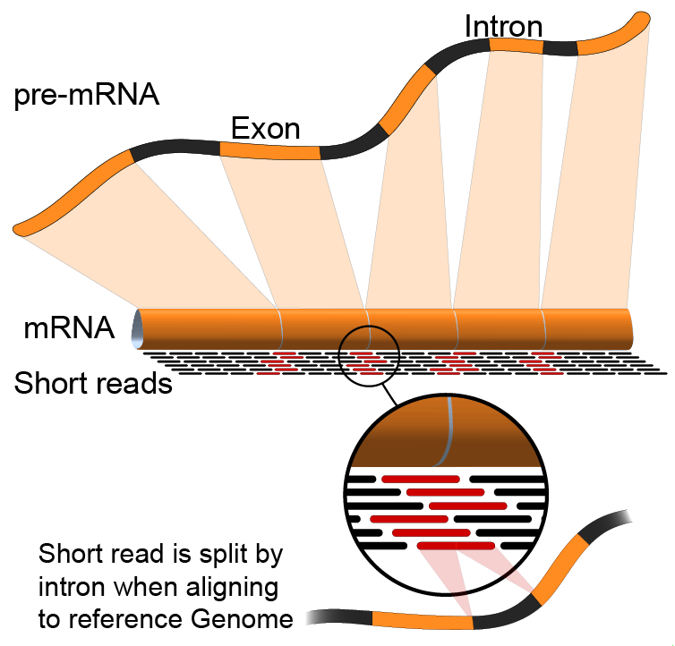
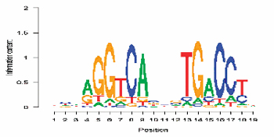
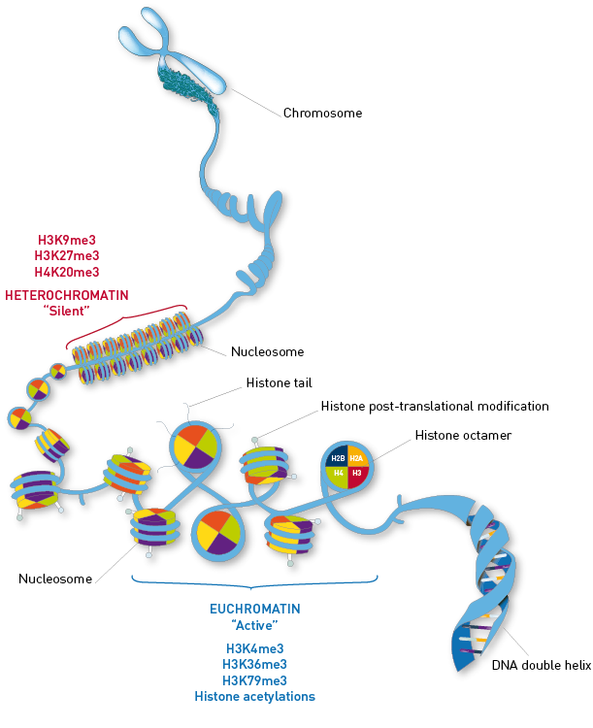
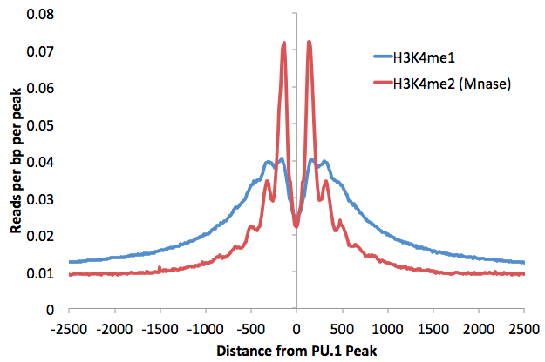
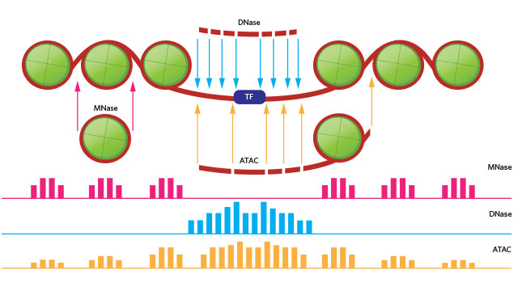
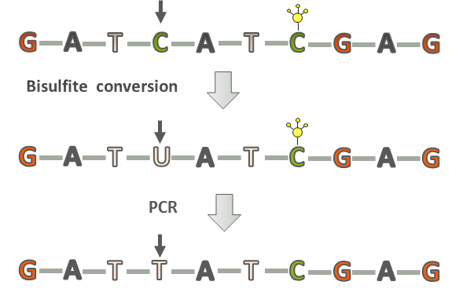
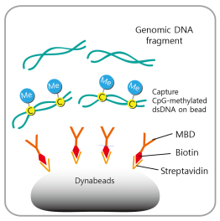
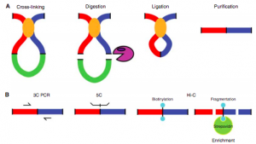
A Data-Acquisition Technology Explosion Enabled by Inexpensive Sequencing
ChIP-seq for
Transcription factor binding
Nucleosome positioning
Histone Modifications
Bisulfite treatment for methylation
MeDIP for methylation
RNAseq
DNase-seq
ATAC-seq
Hi-C
Notes:
As a result of this cost reduction, another amazing thing happened over the past 10 years. Sequencing is more and more used as a molecular cellular assay.
A very large number of experimental techniques and tricks have been developed to assay the molecular biology of cells and tissues by using DNA sequencing as the primary tool.
These assays are high-throughput and whole genome. RNA sequencing measures gene and transcript expression. DNAse and ATAC sequencing measure open chromatin. Hi-C measures proximity of chromatin regions. ChIP sequencing can measure transcription factor binding, nucleosome position, and histone modifications. Bisulfite treatment and MeDIP measure methylation. And so on.
All these assays is that they are high-throughput, hypothesis free, and their purpose is to provide raw measurement data for computational analysis.

Slide 5
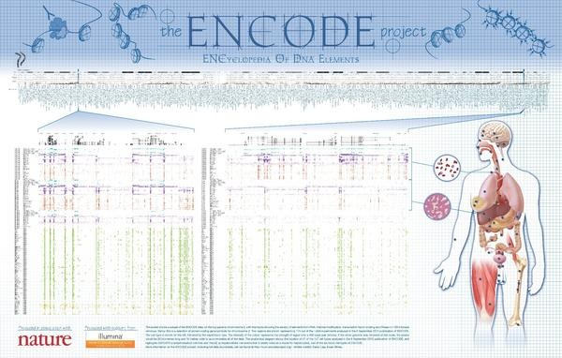
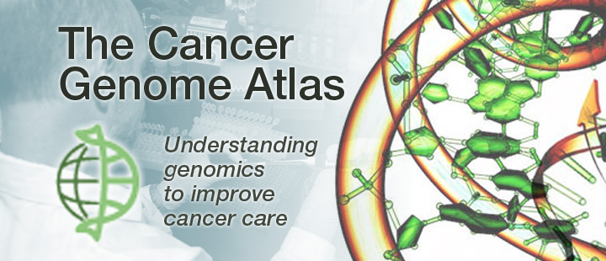
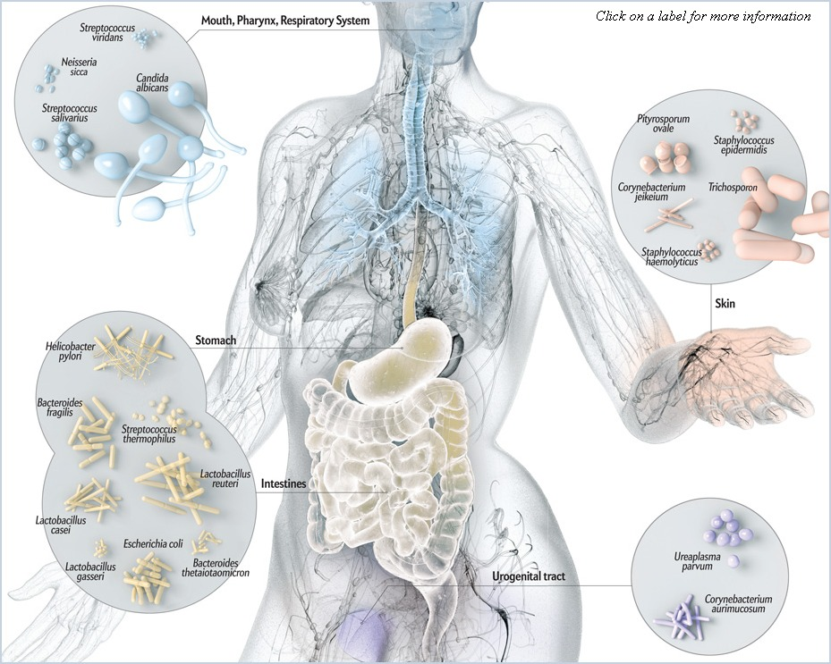

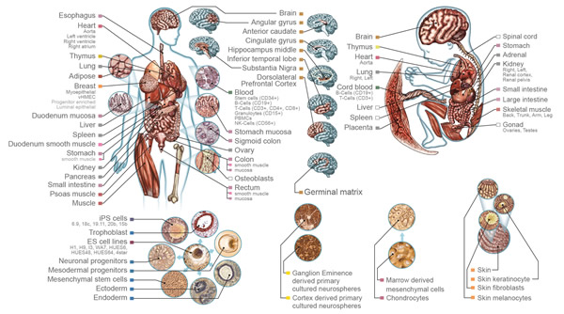
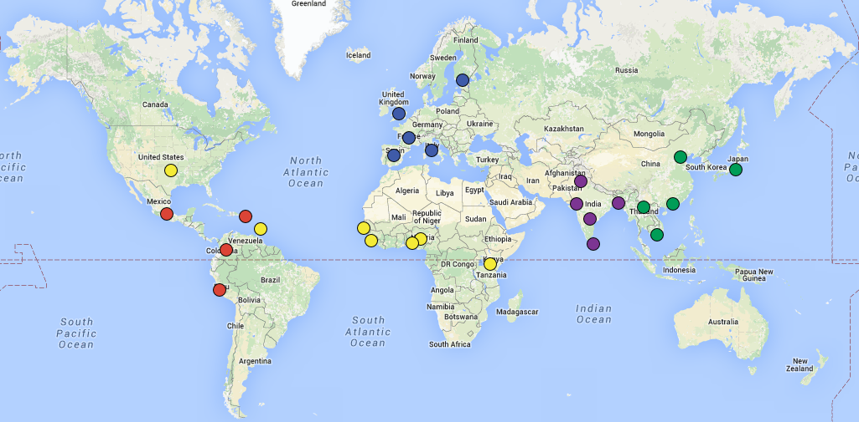
Major Data Acquisition Efforts
Human Microbiome
Roadmap Epigenomics
1000 Genomes
Notes:
A large number of big multi-institution projects have been initiated, whose goal is to use multiple such assays, to provide raw, hypothesis free data to the community for computational analysis.
The ENCODE project is a great example. The main conclusions of the main ENCODE paper have received some criticism. But it is true that the main purpose of ENCODE is not scientific conclusions, but production of raw data for future computational analysis.
Similarly, the Roadmap project is cataloguing the epigenomic states of human genomes. The microbiome project is cataloguing human microbial communities. TCGA is cataloguing cancers, and several population sequencing projects provide raw sequenced genomes.
So, the main focus of genomics over the past 15 years has been quite simple:
Provide hypothesis-free raw data for computational analysis.
So, how about the future? What are we learning from all this data? Are we going to eventually understand human biology with engineering level precision? Cure human diseases? Live forever?

Slide 6
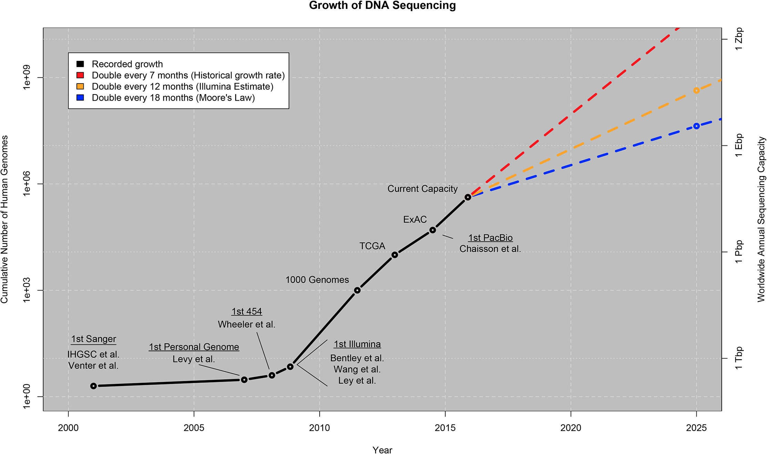
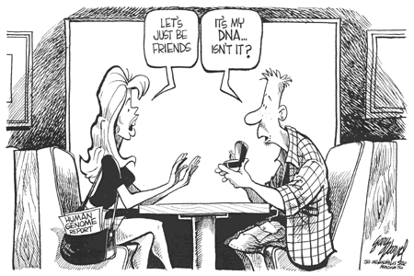
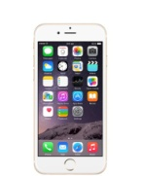
How soon will we all be sequenced?
Applications
Cost
Time
2016?
2022?
1Bn individuals by 2022-2026
Notes:
I actually think these estimates are conservative if anything. There is a reason for that.
As we sequence more and more genomes, and perform various analyses, develop applications, the value of the genomic sequence goes up. The price keeps going down. At some point, by simple market rules, the two lines will cross. That is a point where the market grows very rapidly.
So as we are now entering this process, how can we best learn from the data, what are roadblocks to rapid positive advances, and how can the impact on society be as beneficial as possible?

Slide 7
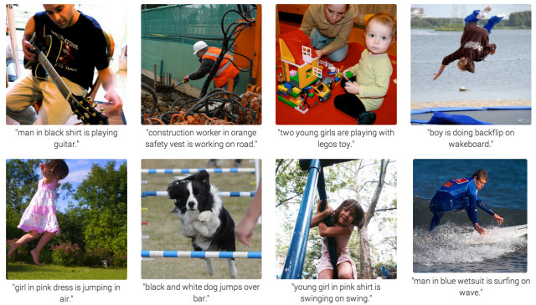
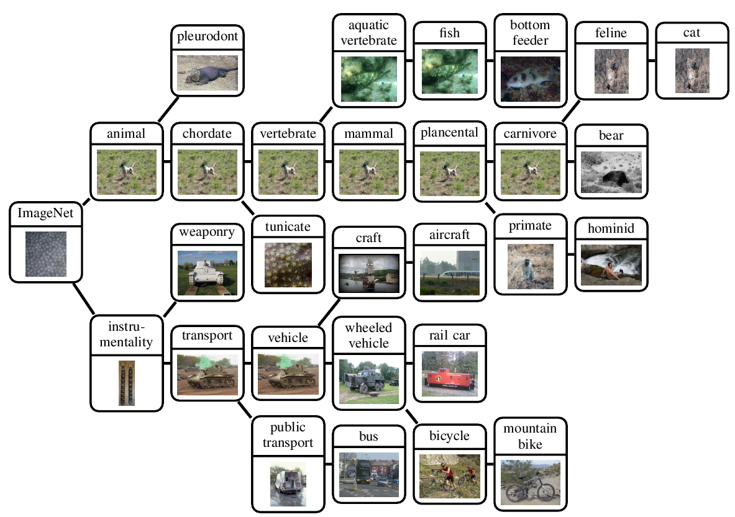
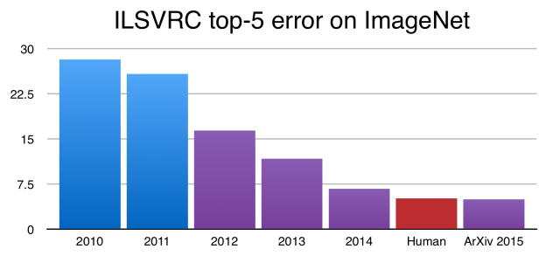
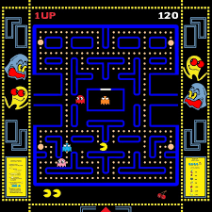
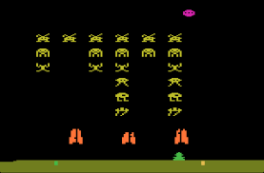
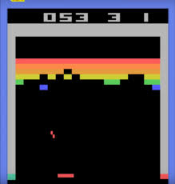
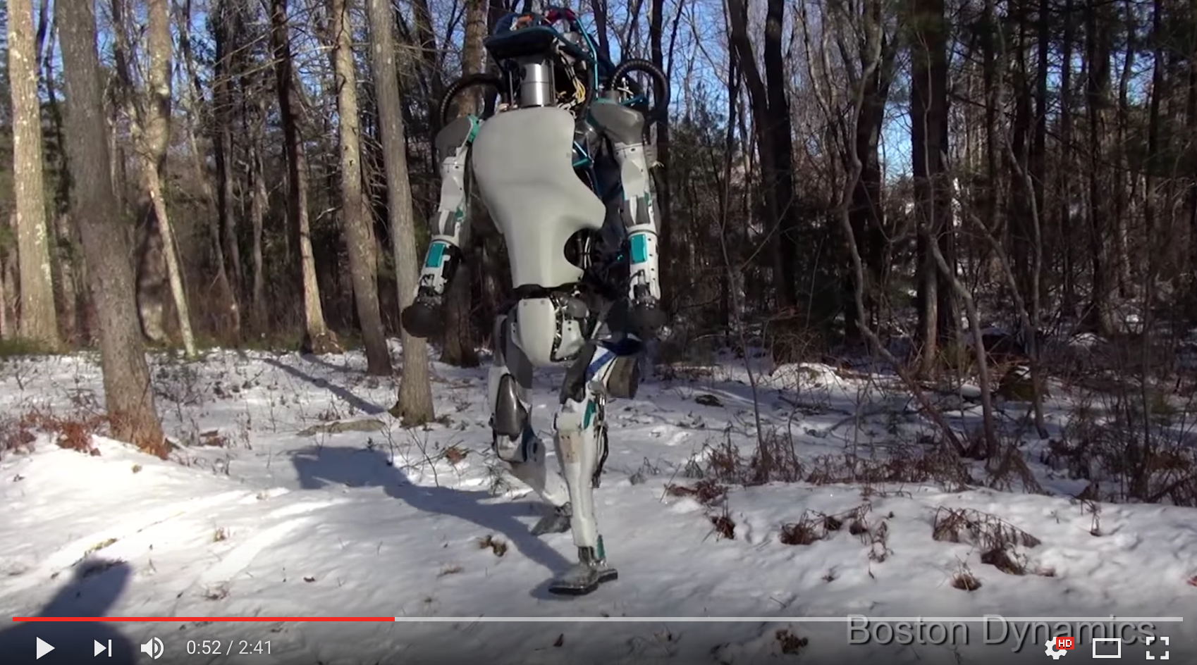
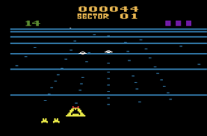
Deep Learning – major AI breakthrough
Introduction of deep NNs
Notes:
One of the first major breakthroughs involving deep neural networks was in image recognition. There is a competition every year, the ILSVRC competition, involving a large catalog of images that come in hierarchies of total 1000 categories.
I remember the time where my colleagues and I in the AI lab would call image recognition an AI-complete problem.
Just a few years ago, Jitendra Malik, an expert in computer vision, was quoted saying that if he sees deep learning matching performance of conventional image recognition techniques, he will be convinced.
Well, we are done with that. In 2012 deep learning vastly exceeded performance of everything before. And moreover, this past december, for the first time, deep learning exceeded the best expert human performance. Those are trained individuals in the specific dataset. You are experiencing deep learning all the time, in google image searches and in Facebook’s photo tagging.
Beyond recognition, deep learning has been applied by my colleague Fei Fei Li at Stanford to label images. You get legends such as:
Man with black shirt playing with his guitar.
Two young girls playing with legos toys.
And
A group of people walking on a city street dressed up like zombies.
I am not sure about the last one. Perhaps it is actually a group of zombies, how does the darn AI know its people? Not a safe thing to assume, but it doesn’t worry because it’s not edible, while the rest of us better be more cautious.

Slide 8
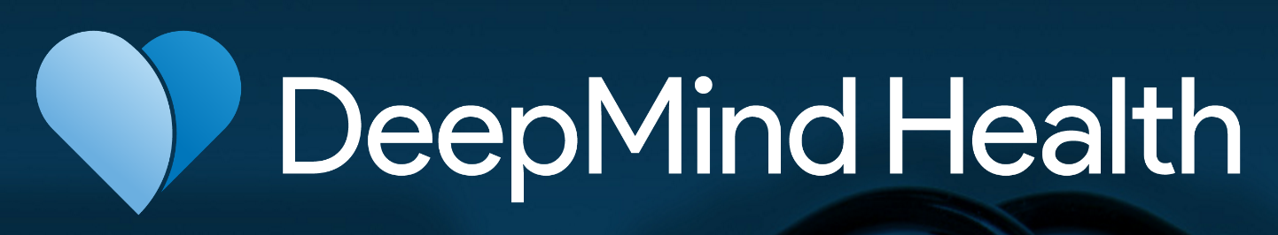
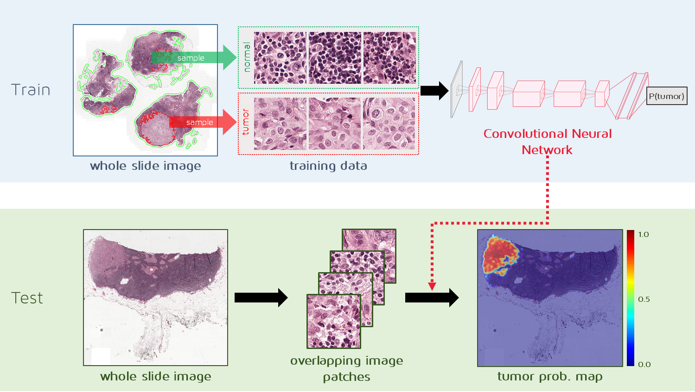
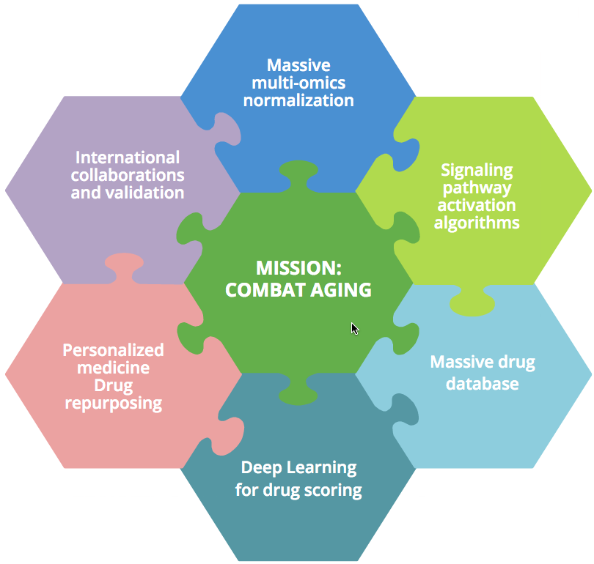


The beginning of deep learning in medicine
Notes:
Perhaps surprisingly, industry has been first in applying deep learning to genomics.
Recently, DeepMind, the Google-owned company that created AlphaGo, announced DeepMind Health. One of their first projects is to collaborate with Moorfield Eye Hospital to apply deep learning to optical coherence tomography scans and automatically detect the onset of diabetes-related eyesight loss and age-related macular degeneration.
And Nvidia together with Mass General Hospital cofounded the MGH Clinical Data Sciences Center, to apply deep learning to all MGH data, starting from images and moving to electronic health records.
And Enlitic, a bay area deep learning startup, has partnered with 80 medical imaging centers in Australia and Asia to analyze MRI, CT, ultrasound and x-ray images. Using the Lung Imaging Database Consortium images, it learned to detect lung cancer nodules in chest CT scans with 50% better performance than a panel of expert thoracic radiologists.

Slide 9
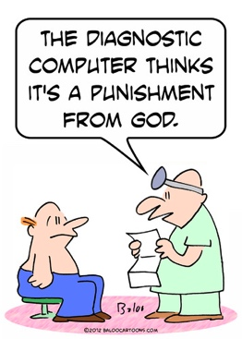
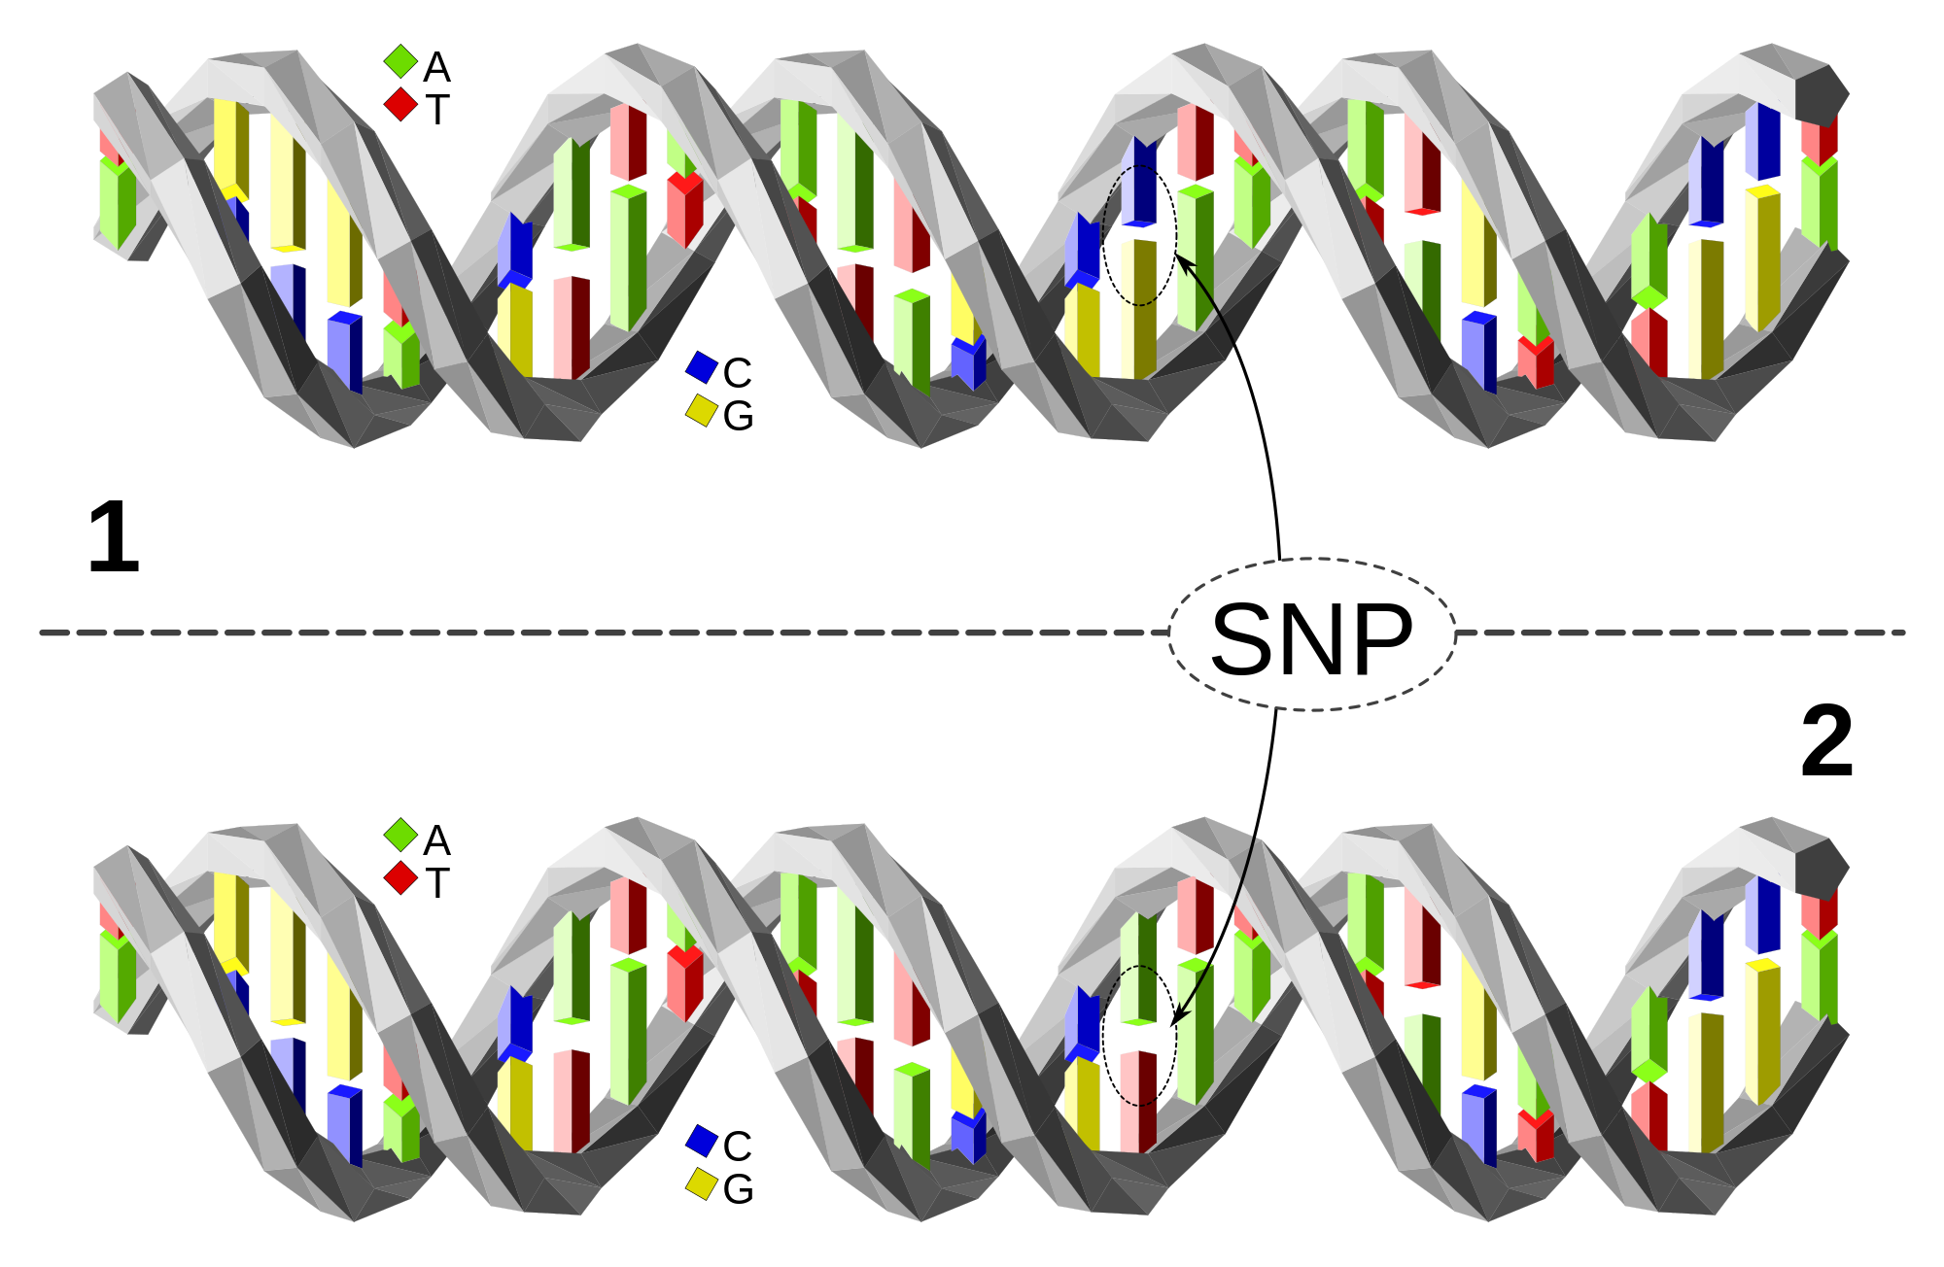
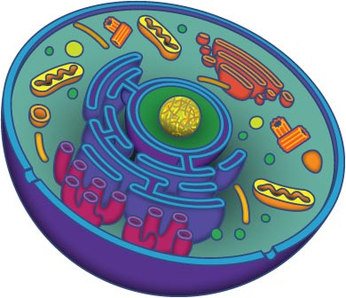
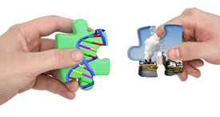
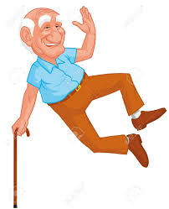
Bet: Biomedicine amenable to deep learning
Current medicine:
With nurse help
Oncology, heart, infectious diseases, dermatology, pharmacology, …, diagnosis, treatment
Benefits:
Improved outcomes
Prediction, prevention
Low cost
Personalized health & prevention
Powerful AI, learning from billions of examples
New drugs & treatments, gene therapy, CRISPR, …

Slide 10
OK, but why “deep learning”?
Let’s digress and talk about
Boolean circuits
Notes:
I would like now to ask the question of why the deep, in deep learning. Machine learning has been around for a while, with impressive accomplishments. Deep neural networks have also been around for a while, but only recently we are able to train them successfully because of
Big data
Technical advances such as ReLU units
GPUs
But is there something inherently more powerful in deep networks than in shallow machine learning methods? To get some intuition, let’s turn to boolean circuits.

Slide 11
OK, but why “deep learning”?
Consider circuits built of: ⋁, ⋀, ¬
⋁
⋀
¬
¬
⋀
¬
⋁
Can always push ¬ to bottom layer
==
==
⋁
¬
¬
⋀
¬
¬
⋀
Assume alternating ⋁, ⋀
Unlimited fan-in
==
⋀
⋀
⋀
C_{n}
Assume a circuit C_{n} that handles all inputs of length n
n
Notes:
Without loss of generality: Tree structure, alternating AND and OR layers, bottom layer is an AND layer, there are no NOT gates except at the very bottom layer: each variable and its negation are inputs.

Slide 12
OK, but why “deep learning”?
A collection of circuits C₁, …, C_{n}, ... is
P-uniform: There is a poly-time Turing Machine that on input n, outputs C_{n}
A language L is computable by a P-uniform circuit family, if and only if L ∈ P
C₁
C₂
C₉
…
…
⋁
Poly(n)
Class AC⁰:
Unlimited fan-in circuits of constant depth d
Assume bottom layer fan-in 1
⋀
⋀
⋀
d
⋁
…
⋁
…
⋁
⋀
⋀
…
⋀
⋀
…
⋀
1
Notes:
Without loss of generality: Tree structure, alternating AND and OR layers, bottom layer is an AND layer, there are no NOT gates except at the very bottom layer: each variable and its negation are inputs.

Slide 13
What can we compute with a constant-depth circuit?
Start with depth-d circuit
Collapse 1st & 2nd layers – Switching Lemma
…
Flatten to 2 layers without making it “too fat”
What can we now compute?

Slide 14
Switching Lemma
k-DNF, n variables
s-CNF, n – t variables
𝛠: fix t random variables
⋁
⋀
f
⋀
…
⋀
⋁
…
⋁
k
k
s
s
Switching Lemma (CNF ←→ DNF)
Prob [ f|_{𝛠} not expressed as a s-CNF ] ≤ q ]
Where q is equal to the ugly:
q = q(k, s, t, n) = ((n-t)k¹⁰/n)^{s/2}

Slide 15
Reducing depth by 1
𝛠_{i}: fix t_{i} random variables
t_{i} = n_{i} - n_{i}^{1/2}
⋀
⋀
⋁
…
⋁
⋀
…
⋀
⋀
…
⋀
⋀
…
⋀
⋁
…
⋁
⋁
…
⋁
…
…
k_{i}
k_{i}
k_{i}
k_{i}
k_{i+1}
k_{i+1}
k_{i+1}
k_{i+1}
Always reduce the bottom layer, initially of fan-in 1
Notes:
NOTE THAT WE CAN CHANGE FAN-IN TO 2, BECAUSE FAN-IN DOES NOT DEPEND ON N

Slide 16
Reducing depth by 1
𝛠_{i}: fix t_{i} random variables
t_{i} = n_{i} - n_{i}^{1/2}
⋀
⋀
⋁
…
⋁
⋀
…
⋀
⋀
…
⋀
⋀
…
⋀
⋁
…
⋁
⋁
…
⋁
…
…
k_{i}
k_{i}
k_{i}
k_{i}
k_{i+1}
k_{i+1}
k_{i+1}
k_{i+1}
Always reduce the bottom layer, initially of fan-in 1
Notes:
NOTE THAT WE CAN CHANGE FAN-IN TO 2, BECAUSE FAN-IN DOES NOT DEPEND ON N

Slide 17
Reducing depth by 1
𝛠_{i}: fix t_{i} random variables
t_{i} = n_{i} - n_{i}^{1/2}
⋀
⋀
⋁
…
⋁
⋀
…
⋀
⋀
…
⋀
⋁
…
⋁
⋁
…
⋁
…
…
k_{i}
k_{i}
k_{i}
k_{i}
k_{i+1}
k_{i+1}
k_{i+1}
k_{i+1}
Switching lemma: bottom layer gates don’t become too ”fat”
Notes:
NOTE THAT WE CAN CHANGE FAN-IN TO 2, BECAUSE FAN-IN DOES NOT DEPEND ON N

Slide 18
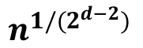
Reducing depth by 1
𝛠_{i}: fix t_{i} random variables
t_{i} = n_{i} - n_{i}^{1/2}
⋀
⋀
⋁
…
⋁
⋀
…
⋀
⋀
…
⋀
⋁
…
⋁
⋁
…
⋁
…
…
k_{i}
k_{i}
k_{i}
k_{i}
k_{i+1}
k_{i+1}
k_{i+1}
k_{i+1}
After d-2 steps, each applied to all layer-2 gates:
# variables left:
depth: 2
fan-in: 10 b 2^{d-2}, where circuit size = n^{b}
After some hairy calculations,
$$n^{1/(2^{d−2})}$$
Notes:
NOTE THAT WE CAN CHANGE FAN-IN TO 2, BECAUSE FAN-IN DOES NOT DEPEND ON N

Slide 19
Final Circuit
Turn any circuit family in AC⁰ into 2-layer
If n large, #vars >> fan-in
Fix c vars, make output constant = 0
Now take f = parity(x₁, …, x_{n})
≠ constant by fixing any s < n variables
Therefore, f ∉ AC⁰
A “shallow” ML method cannot compute parity unless exponential # features
How about HMM, K states? N layers, each layer receives log K bits from previous layer. Can do parity, but limited to simple functions
Shallow ML seems unable to replace general algorithms
⋀
⋁
…
⋁
…
…
c
c
# variables left:
depth: 2
fan-in: c = 10b2^{d-2}
$$n^{1/{(2}^{d−2})}$$

Slide 20
Biggest Obstacle: wide, free data availability
Ideal:
Millions of publicly available genomes, medical records, phenotypes, environment
Far-reaching anti data-based discrimination laws; GINA: great start
Not ideal:
Data silos in hospitals, health care providers, gov’t, direct-to-consumer companies
Specialized large-scale projects (1000 genomes but no phenotypes/medical records)
What about privacy?
No cancer patient has died yet because of data privacy breach
My Facebook page reveals much more private stuff about me than my genome or medical record
Let’s make our data public – if 5% of us do, probably enough to solve medicine
Let’s do so without waiting for legislation
“I don’t want to live in a world where someone else makes the world a better place better than I do.”
Notes:
So what is the biggest obstacle for essentially all of current medicine to be done vastly better in the next decade or two, and moving beyond that, for much better health, enhancements, and even dramatic extension in healthy, young lifespan?
In my opinion, the biggest obstacle is data silos. We do not want data to be owned by hospitals, health care providers, and especially not by individual labs. We want data to be widely, easily, and pervasively free.
What about concerns of privacy? That’s why we also need good laws preventing abuse. However, no cancer patient has ever died because their data privacy was breached. Facebook has already breached my data privacy – if you want to learn about me, you will be better off adding me as a Facebook friend, than getting access to my genome and health record.
More than anything we need a strong law that requires anyone who wants to make their data publicly available, to have the right to do so. No pharma, hospital, or principal investigator, can hide behind their finger of “patient privacy”.
Let’s all make our data public. I certainly will. More than anything we need easy portals to deposit our free data.
And to reiterate what I think is big problem, data silos. As I saw a quote of a narcissistic CEO TV character. I don’t want to live in a word where someone else makes the world a better place better than we do.

Slide 21
Some examples to follow
You think recycling saves the world?
Try data sharing!
Anti-discrimination law and public awareness extends to all genetic and medical information
Data hoarders (academia, hospitals, industry) akin to polluters
Notes:
Here is a good example to follow. Recycling.
You think recycling is saving the world? Try data sharing!
You see, recycling goes beyond being practical, and has become almost a moral responsibility. Several years ago I visited some friends, an elderly couple Bob and Marilyn, in their place in Napa. They became wealthy in real estate, and they had a huge mansion in Napa. Marilyn unfortunately passed away since then, from cancer. She fought cancer over 40 years, and eventually in her late eighties she could not fight it again.
So that day, I remember I had a diet coke. Once I was done, Marilyn took my can to recycling, explaining to me that they always recycle. That’s commendable, but of course in practice it means very little, because it reduces their carbon footprint by epsilon, given that they have a 20 acre mansion with big heated pool.
So what is my point? Environmental movement has made recycling a moral issue. That’s great. We should do the same for data sharing!
How about privacy concerns? Well, many of us agree that there is still different sorts of discrimination in society. But we also hopefully all agree that in the recent past we have done extremely well as a society to limit discrimination. I am all in favor of racial equality in the law and in being treated the same. Sex equality, gay marriage, bathrooms respective everyone’s chosen gender identity. The same principles will help us with any concerns raised through loss of privacy.
Do we want only the government and big pharma and big healthcare to have our data? Much better if everyone has our data!
And finally, let’s develop a sense that data hoarding is bad. Nobody likes big polluters. Nobody should like data hoarders. In short, if I personally want to make my health and genome data available, I should have the right to demand it from whoever has my data.

